Slide 1
HR-data-analysis
by Aiste Saltenyte
HR data analysis of attrition in the company using a logistic regression.
Data sampled from Vijay Choudhary's "HR Analytics Case Study"

Slide 2
Excerpt from the description of the data set (Edited)
Problem Statement
A large company named XYZ, employs, at any given point in time, around 4000 employees. However, every year, around 15% of its employees leave the company and need to be replaced with the talent pool available in the job market. The management believes that this level of attrition (employees leaving, either on their own or because they got fired) is bad for the company, because of the following reasons:
The former employees’ projects get delayed, which makes it difficult to meet deadlines, resulting in reputation loss among consumers and partners
A sizeable department has to be maintained, for the purposes of recruiting new talent
More often than not, the new employees have to be trained for the job and/or given time to acclimatise themselves to the company
Hence, the management has contracted an HR analytics firm to understand what factors they should focus on, in order to curb attrition. In other words, they want to know what changes they should make to their workplace, in order to get most of their employees to stay. Also, they want to know which of these variables are most important and need to be addressed right away.
Goal of case study:
You are required to model the probability of attrition using a logistic regression. The results obtained will be used by the management to understand what changes they should make to their workplace in order to get most of their employees to stay.

Slide 3
Libraries and modules used in the analysis
pandas as pd
matplotlib.pyplot as plt
numpy as np
seaborn as sns
sklearn
%matplotlib inline
scale from sklearn.preprocessing
mean_squared_error, r2_score from sklearn.metrics
statsmodels.api as sm
statsmodels.formula.api as smf
train_test_split from sklearn.model_selection
variance_inflation_factor from statsmodels.stats.outliers_influence
add_constant from statsmodels.tools.tools
LogisticRegression from sklearn.linear_model
classification_report, confusion_matrix from sklearn.metrics
accuracy_score from sklearn.metrics
metrics from sklearn

Slide 4
Information obtained from data sample
From general data set:
Age
Attrition
BusinessTravel
Department
DistanceFromHome
Education
EducationField
EmployeeCount
EmployeeID
Gender
JobLevel
JobRole
MaritalStatus
MonthlyIncome
NumCompaniesWorked
Over18
PercentSalaryHike
StandardHours
StockOptionLevel
TotalWorkingYears
TrainingTimesLastYear
YearsAtCompany
YearsSinceLastPromotion
YearsWithCurrManager
From employee survey data set:
EmployeeID
EnvironmentSatisfaction
JobSatisfaction
WorkLifeBalance
From in time and out time data sets:
EmployeeID
Employees‘ in time
Employees‘ out time
From data dictionary:
Descriptions of variables in general and survey data sets

Slide 5
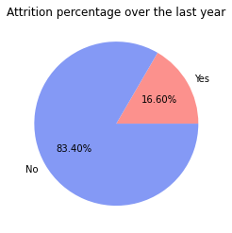
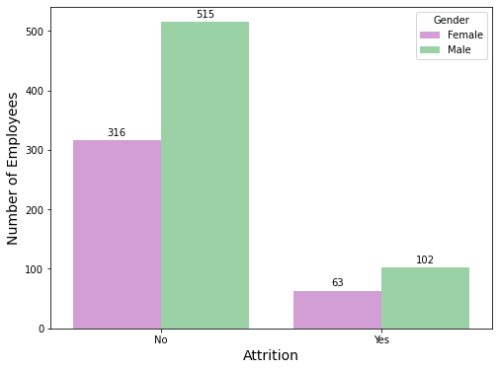
First look at the Data
From the given data we can see that there is a 16.6% attrition in the company.
Attrition based on gender shows that 63 females and 102 males left the company over the last year.

Slide 6
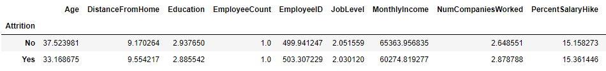
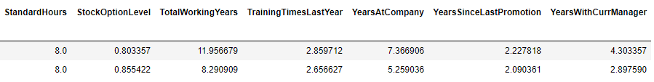
First look at the Data
By looking into the averages based on Attrition we can see noticeable differences in some of the variables.
On average younger employees are more likely to leave the company.
Lower monthly income might also have an impact, as we can see that monthly income of those who have left the company is on average lower than of those who did not leave.
Employees with lower number of total working years as well as with lower number of years at the company might have a tendency to leave the company, as average Total Working Years and average Years At Company of those who have left are lower, than of those who stayed at the company.
Therefore, these features should be looked into further, as they might have a great impact on the attrition.

Slide 7
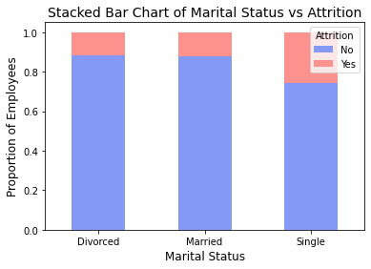
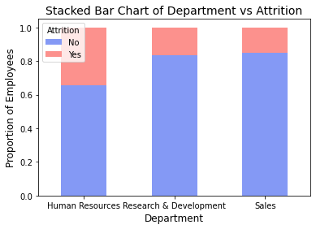
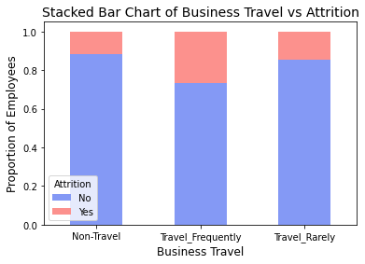
General Analysis
From the graphs below we can see that there are some proportional differences in Attrition based on the Marital Status, Department and Business Travel variables. Therefore, these features might have a significant impact for Attrition and should be considered in further analysis.

Slide 8
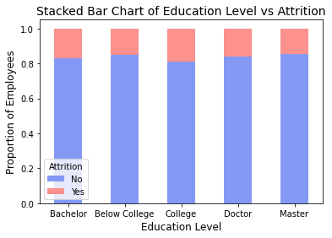
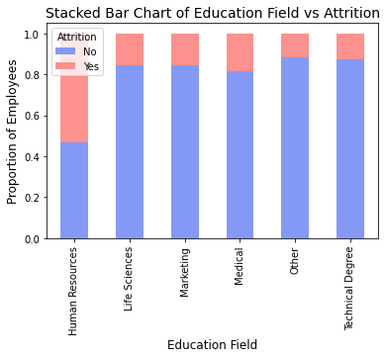
Looking into Attrition proportions based on other variables

Slide 9
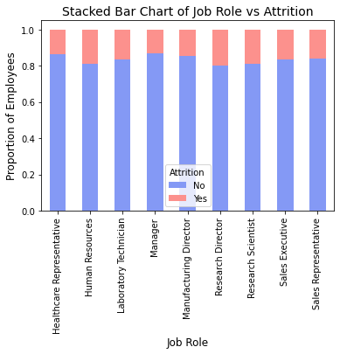
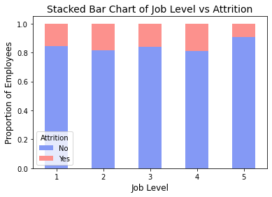

Slide 10
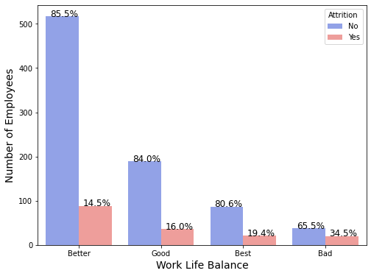
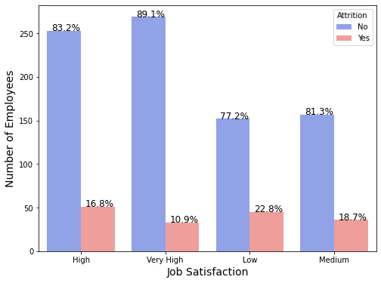
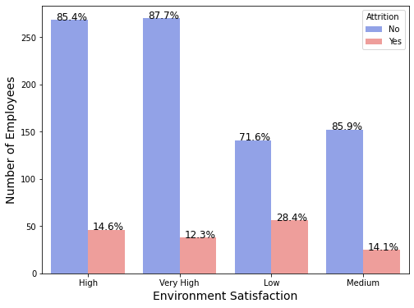
From the graphs we can see that employees who think that Work Life Balance is Bad in the company tend to leave the company more than others. Moreover, employees whose Environment Satisfaction is Low in the company tend to leave the company more than others as well as the employees with low Job Satisfaction.

Slide 11
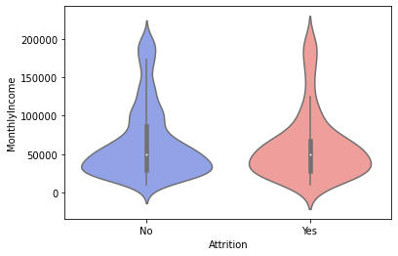
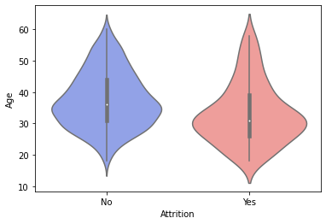
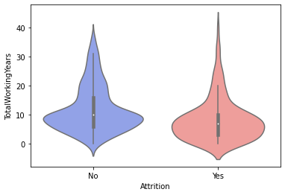
Looking into some variables’ distributions based on the attrition to see if certain differences can be spotted

Slide 12
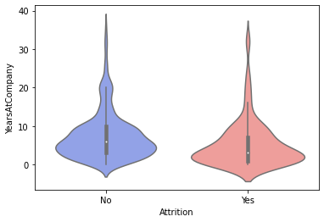
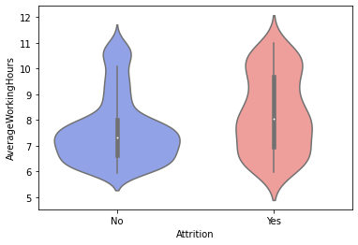
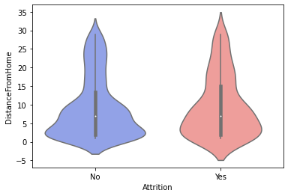
From the graph below we can see that there is a quite different distribution of average working hours between employees who have left the company and those who have stayed in the company

Slide 13
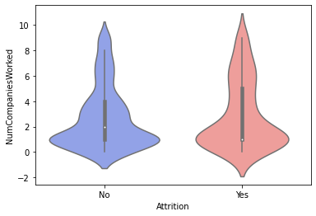
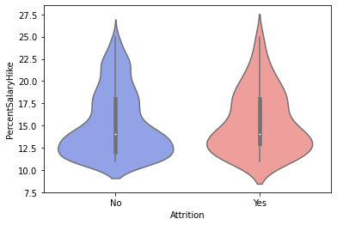
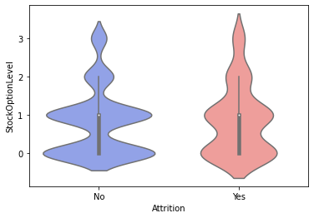
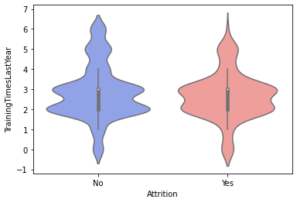

Slide 14
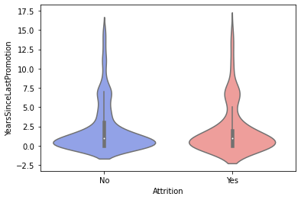
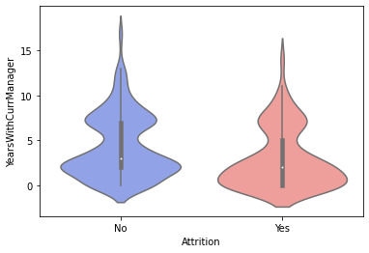

Slide 15
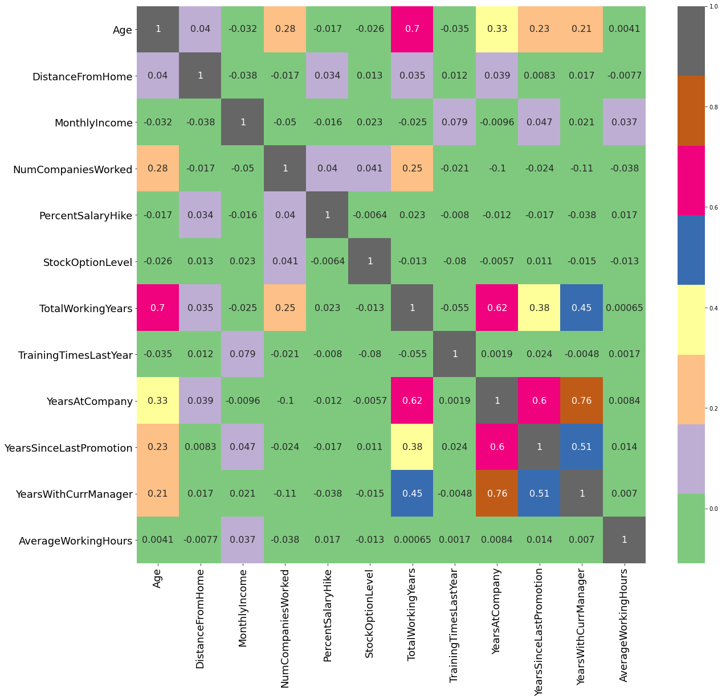
Looking into collinearity among predictor variables
From the Heat Map we can see that some variables have quite high correlation coefficients. This should be taken into consideration in further analysis in order to eliminate possible collinearity among predictor variables.

Slide 16
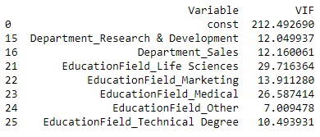
Variance Inflation Factor (VIF)
By calculating VIF (Variance Inflation Factor) we are able to eliminate variables with collinearity in the model.
After eliminating variables with VIF value bigger than 5, we are left of with variables which can be used for further analysis.

Slide 17
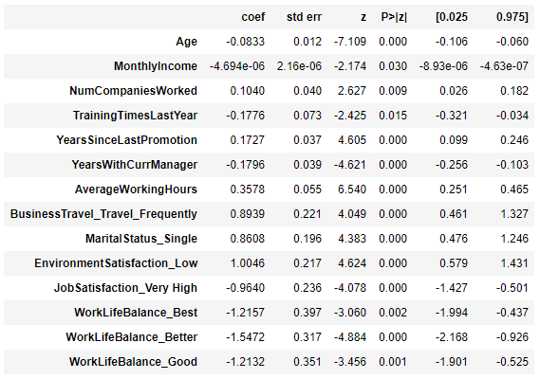
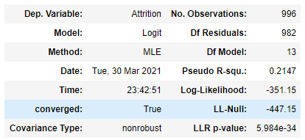
Logit Regression
By running Logit Regression we can look into model’s P values and eliminate variables which have P values bigger than 0.05.
After a few rounds of Logit Regression we are left of with statistically significant variables which can be used for further analysis.

Slide 18
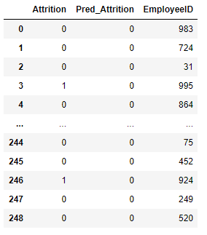
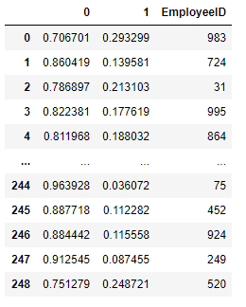
Logistic Regression
By running Logistic Regression we are able to construct model which can predict values with given input.
In this analysis, model predicts if employee is going to leave the company or not.
Moreover, by using constructed model we can find out the probabilities that the predicted output is equal to zero or one (respectively probability of employee staying and probability of employee leaving the company in this case study).

Slide 19
Conclusions:
Based on the analysis we can see that there are quite a few factors which might have an impact on employees' attrition. Therefore, the organization could look into these factors:
Age: younger employees have a higher risk of attrition.
Monthly Income: employees with lower monthly income have a higher risk of attrition
Number Companies Worked: employees who worked in more different companies have a tendency to leave.
Training Times Last Year: employees with longer training hours have lower risk of attrition.
Years Since Last Promotion: employees who did not get a promotion for the last 5 years have higher risk of attrition.
Years With Current Manager: the more years worked with the same manager the less risk of attrition.
Average Working Hours: longer average working hours increase the risk of attrition.
Business Travel: employees who travel frequently have a higher risk of attrition.
Marital Status: employees with the marital status of single have a higher risk of attrition.
Environment Satisfaction: employees with Low Environment Satisfaction have a higher risk of attrition.
Job Satisfaction: employees with very high Job Satisfaction have lower risk of attrition.
Work Life Balance: the better Work Life Balance level the lower risk of attrition.
By looking into these factors the organization could make some decisions and organizational changes in order to improve the overall environment and, in turn, reduce the attrition rate in the company.

